Slide 1


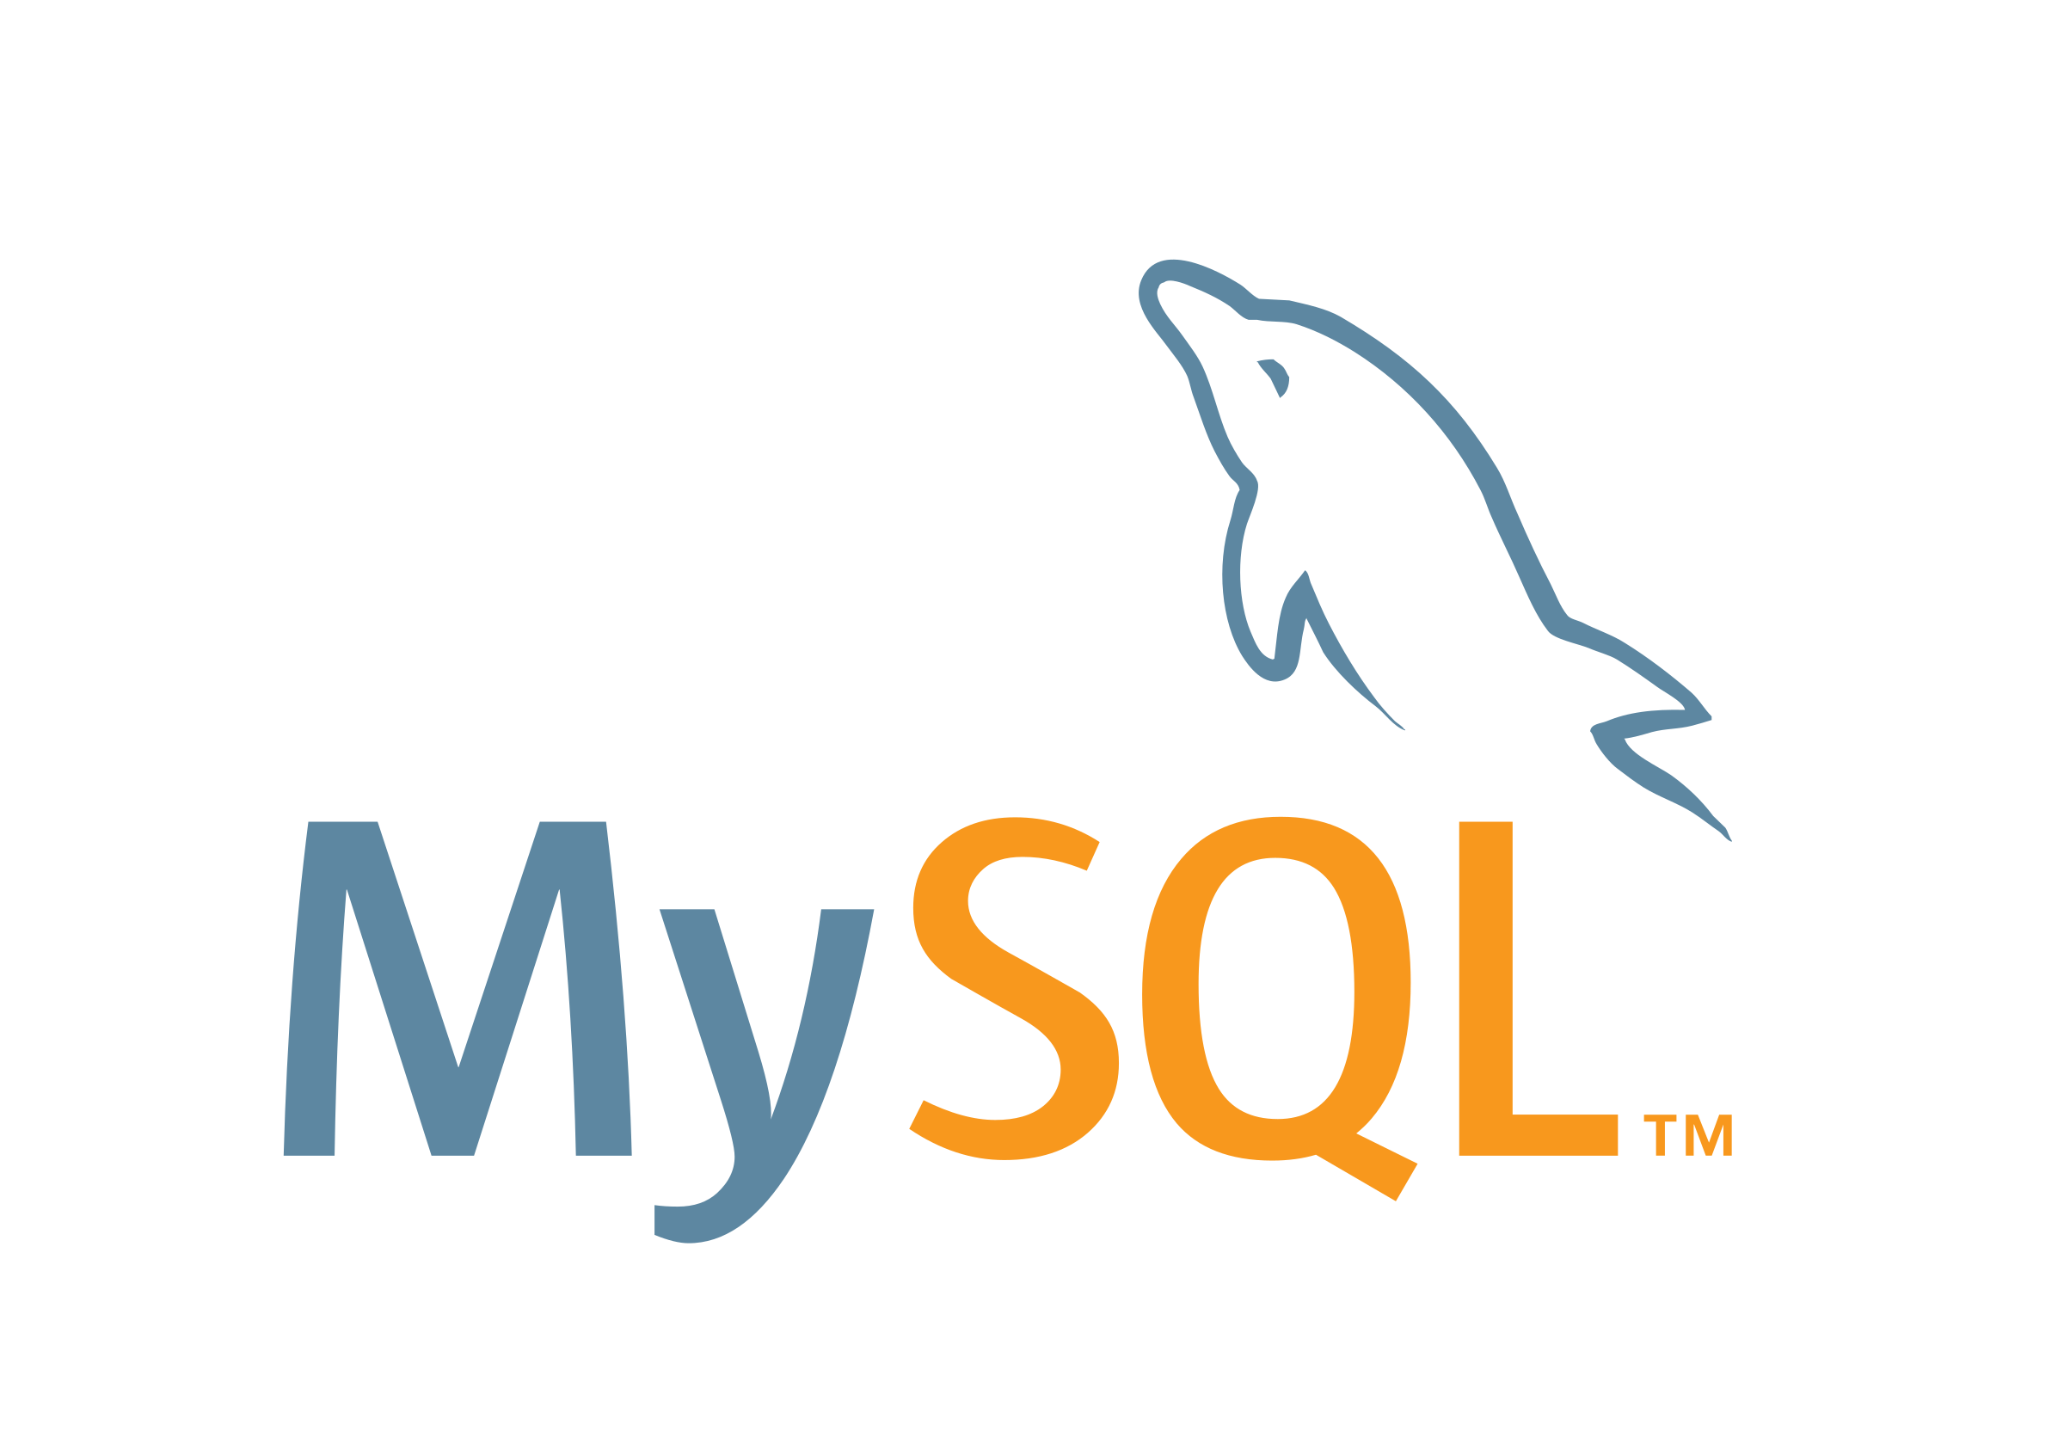




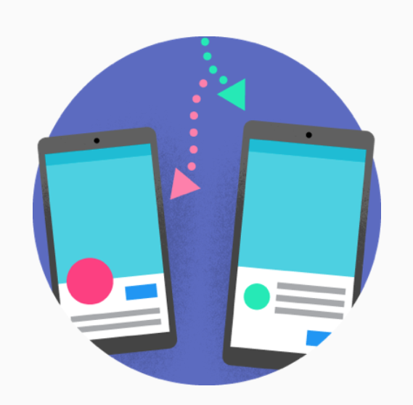
TECHNICAL APPROACH
Choose the most suitable Intent out of different Intents (Matching Training Phrase)
Handle the request, Call the function mapped with the requested Intent
Execute SQL Query
Speech to Text
Invoke Amico action
OR
Call action intents
Request with the asked Text
JSON Request
Request Query Execution
Capture Parameters
Get the data from Database (if Required)
Ok Google, talk to Amico
To get Response, Call the Fulfilment Webhook
Welcome to Amico
Text Message
JSON Response
Response of Query
Construct the JSON Response as per Actions Format
Return Text Response
Return Response
Text to Speech
Action Simulator
Alpha Testing
Beta Testing

Slide 2
Agent Creation
Application Setup
Handling Requests from Dialogflow
Storing Data
NLP & Training agent
Ok Google, talk to Amico
Action Building
Execute Requested Queries
Processing Requests & Sending Response
Intent Writing
Welcome to Amico
Testing
Entities Creation
Sending Query Response
Publish Voice App
Database Connection
Configuring Fulfillment to interact with Webhook
BACKEND
Database

